Slide 1
Planner-Gantt
Apps4.Pro
PRO

Slide 2
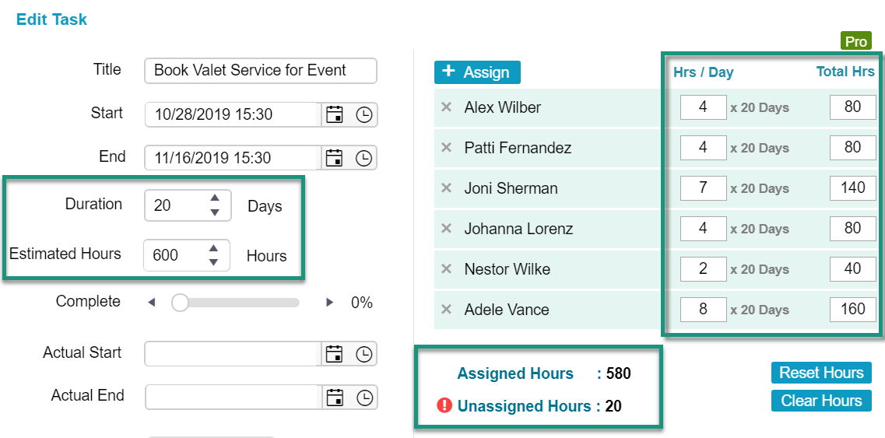
Hourly Estimation
In PlannerGantt Pro, now you can set work hours for individual tasks. Based on the work hours, you can assign members and set how many hours a member should work in that task. It is quite easy to manage and use your resources efficiently.
There is a separate indication Assigned and Unassigned hours that relates works hours of the task and total work hours assigned to members.
To enable or disable this feature, go to settings and select Resource Planning

Slide 3
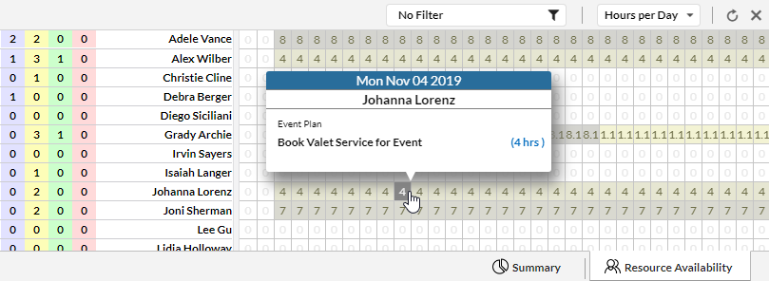
Hourly Estimation
By selecting Hours per Day in resource availability tab you can see each member's total work hours of all tasks he is assigned on each day. Click on each day work hours to view the detailed information.

Slide 4
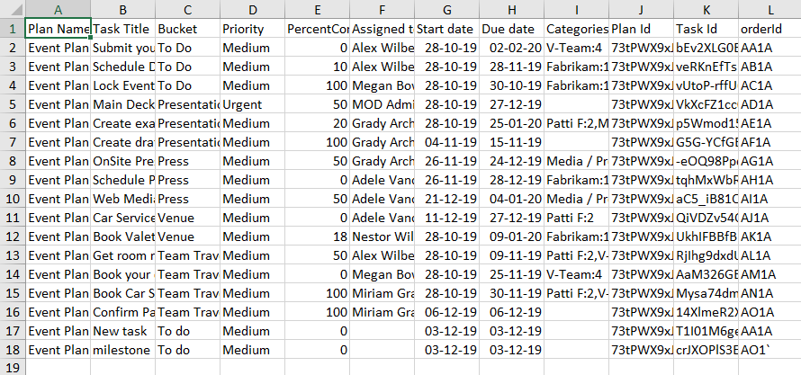
Template Export-Import
Previously there is no way to copy an existing Gantt and make a new one. From this version you can make this happen using template Export-Import. So, you don’t need to create an existing look alike Gantt from its scratch. You can save any plan as a template and make an exact copy. You can use this Gantt chart template as a standalone document to help you track your plan’s schedule. This will save your time, use your resources efficiently and plan your work much faster.

Slide 5
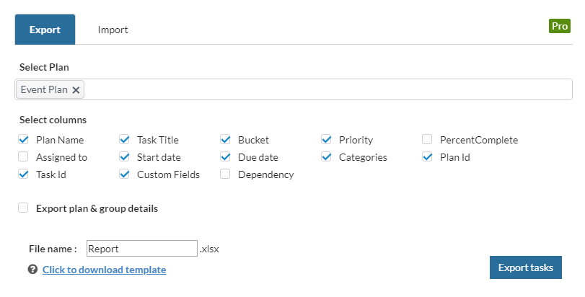
Template Export-Import
For Exporting, select plans and fields you want to export. You can select Plan & Group details for exporting plan and group details when creating new plans.
User can also export multiple plans in a single excel file.

Slide 6
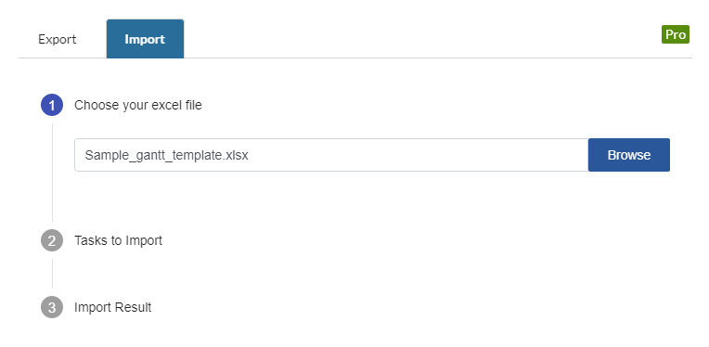
Template Export-Import
For importing, select the exported template file and select fields you want to import.
If you import a template to its own plan, it will detect whether importing tasks are already exist or it’s a new one. If its an existing task, it will update its details instead of creating new one.

Slide 7
Apps4.Pro
Planner-Gantt
Pro
Hope this features will help you to stay productive.

