Slide 1
Apps4.Pro Planner Manager

Slide 2
Apps4.Pro Planner Manager - Introduction
One stop destination for managing planner more effectively and easily
Saves time for manager and helps users to work more effectively and planned
Managers can review their plan performance using various build in reports and adjust wherever necessary

Slide 3
Key Features
Export / Import Planner tasks
Plan templates
Copy / Move tasks between plans
Generate custom reports
Create custom tasks fields
Calendar / Timeline view of tasks
Backup / Restore plans and its tasks
Auto Schedule : Backup Tasks in OneDrive
Auto Schedule : Backup Tasks in Local Storage
E-mail Plans/Tasks report
Add new Plan and Edit existing plan
Add/Remove Plan Members

Slide 4
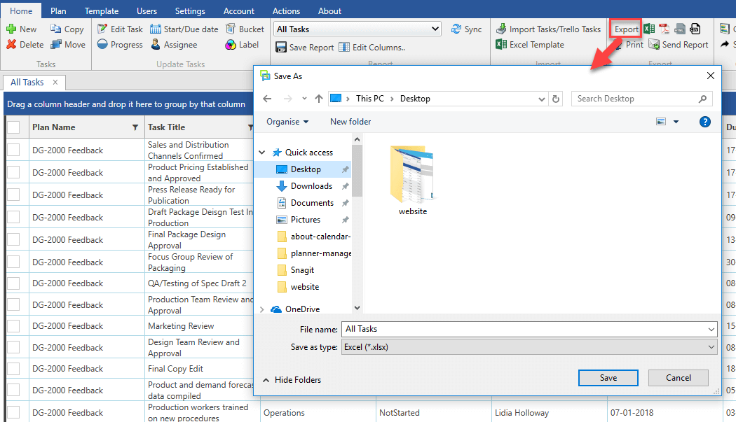
Export Planner tasks(Plan Templates)
Backup for the tasks and users can recreate the plan with the same tasks just by importing it back
Can be used as template to create new plans from scratch.
Bulk edit the tasks in Excel and import back for updating those in Planner.
Supported Formats: Excel, PDF, CSV, HTML

Slide 5
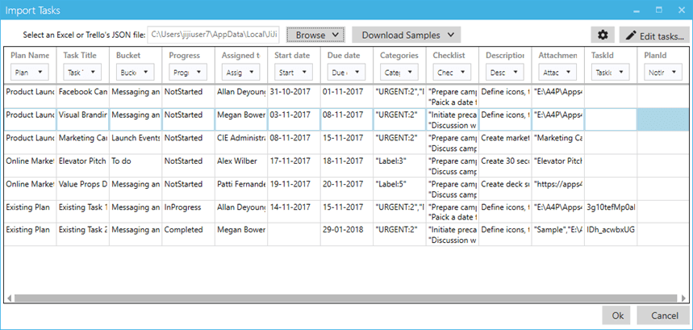
Import Planner tasks from Excel
Update below Planner tasks fields using Import
Task title
Assigned to
State / Due date
Category
Checklist
Bucket
Progress
Description
Attachment

Slide 6
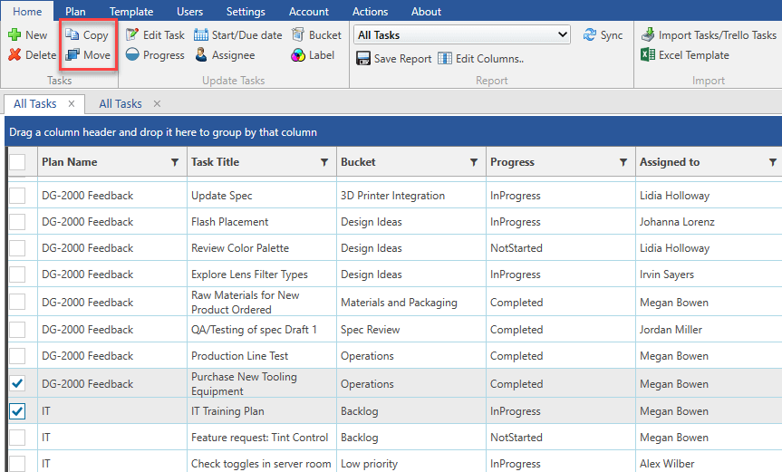
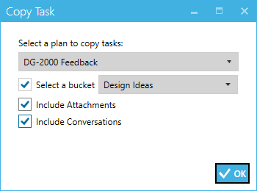
Copy / Move tasks between plans

Slide 7
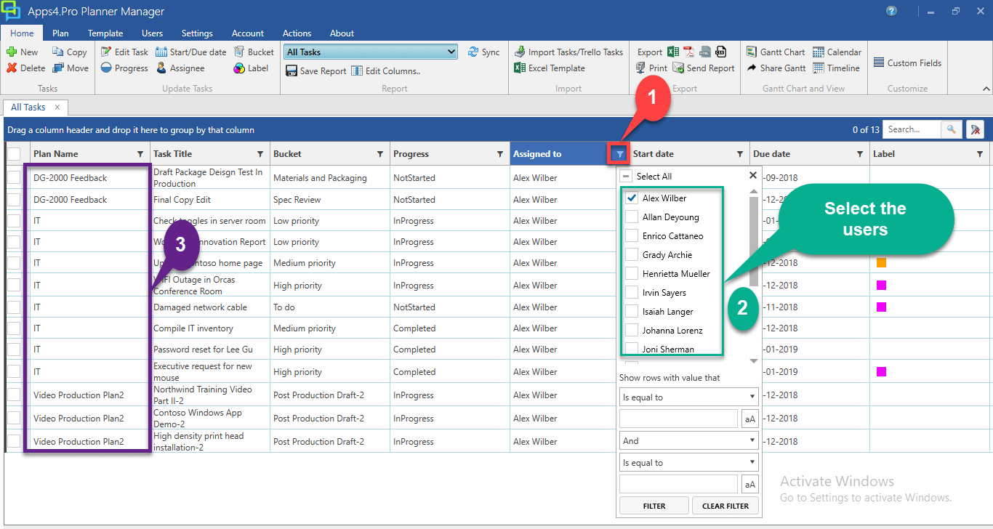
Custom Report - View all Tasks Assigned to an User across all Plans

Slide 8
Custom Fields
Provides the ability to create custom fields in Planner tasks.
Custom fields are available only when Plans are accessed using Apps4.Pro and used for reporting purposes.
Ex: Time spent for the task, Priority.
These fields are Plan specific and you can set different custom fields for each plans.

Slide 9
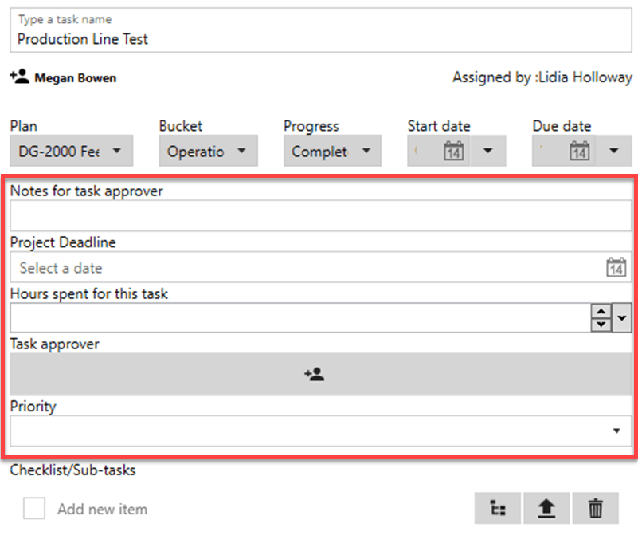
Custom Fields – Supported Types
Single / Multi line (Ex: Notes for approver)
Date/Time (Ex: Project deadline)
Number (Ex: Hours spent for this task)
User (Ex: Responsible person for this task)
Options (Ex: Priority - High, Medium, Low)
Label-Map

Slide 10
Calendar / Timeline view for tasks
This view provides graphical representation of tasks in a calendar.
Helpful for users to find out the tasks that are queued up for the day.
View the tasks by Day, Week, Month or Timeline.

Slide 11
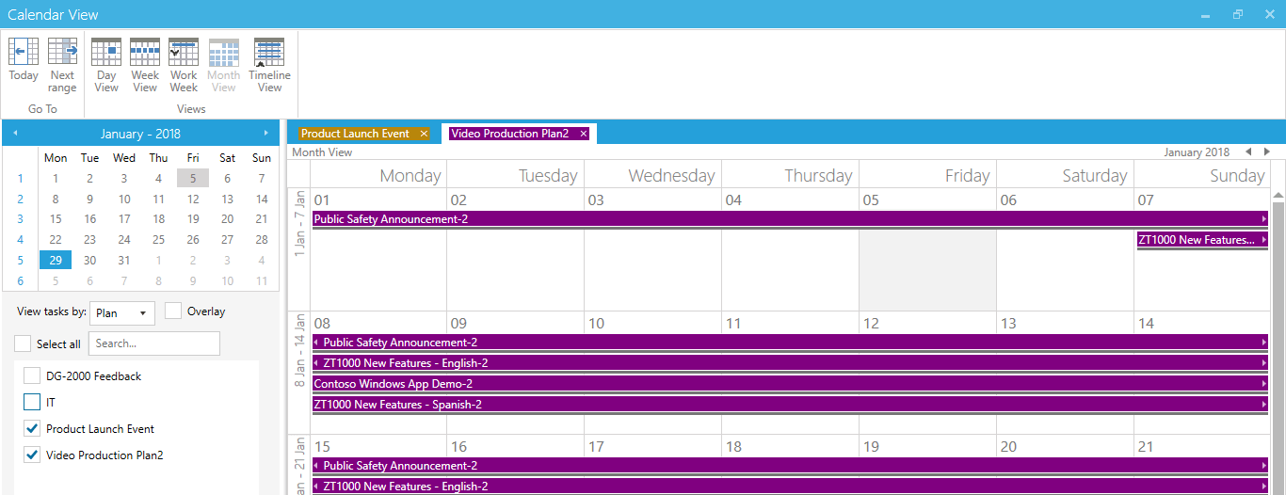
Calendar view

Slide 12
Timeline view

Slide 13
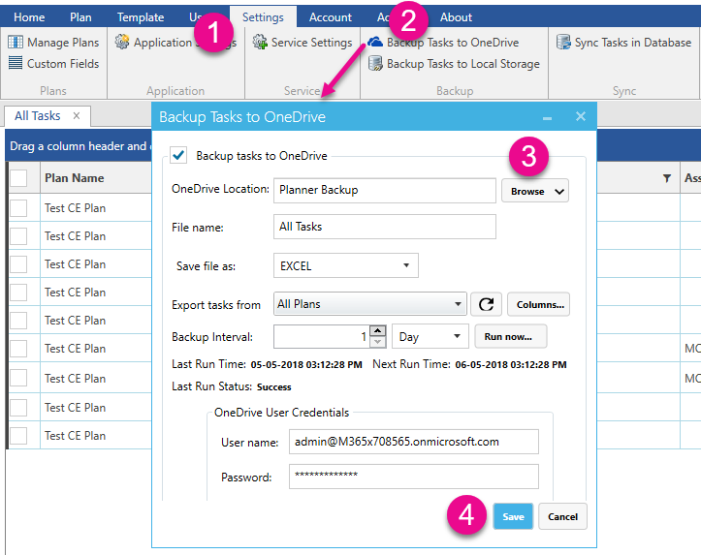
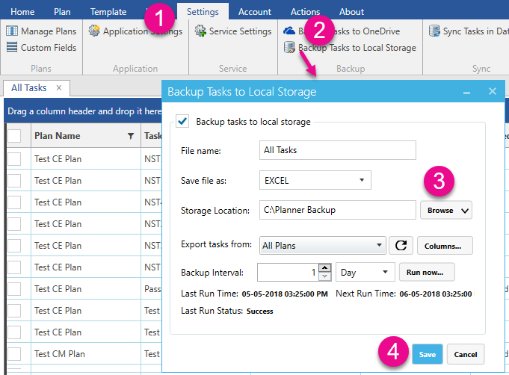
Auto Schedule – Automatically backup and export tasks to OneDrive and Local Storage

Slide 14
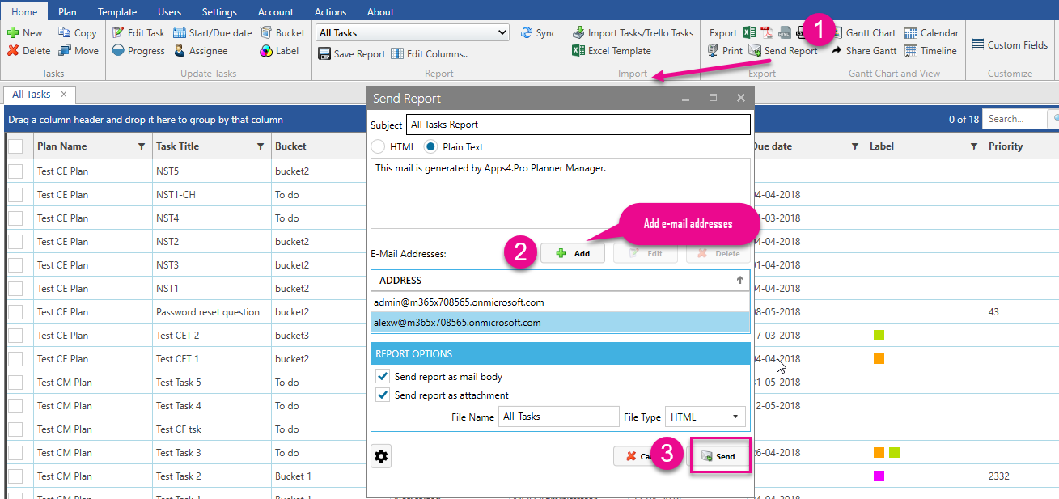
Send plans/tasks report to specific e-mail addresses

Slide 15
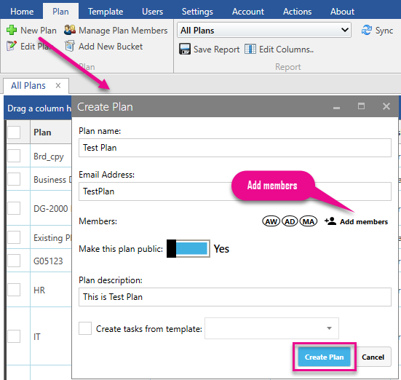
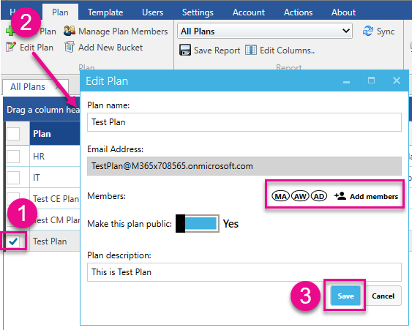
Can create new plan with members and edit existing plan details (plan name, description and members)

Slide 16
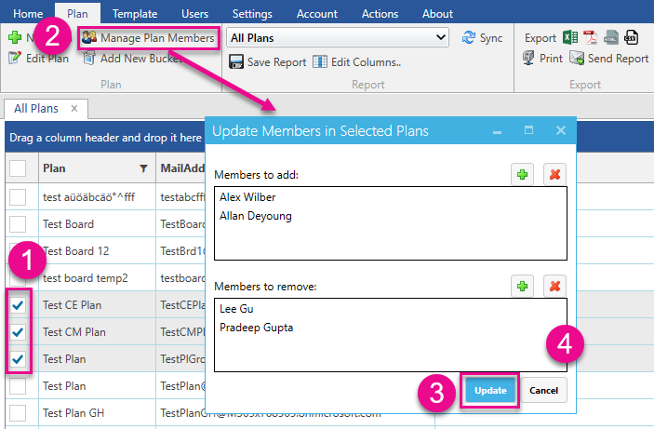
Add/Remove members from the associated group of the selected plans

Slide 17
Contact Us
Email: sales@jijitechnologies.com
Yammer: https://www.yammer.com/apps4pro

